Slide 1
Firefly for parents
June 2022

Slide 2
Firefly allows you to see your child’s…
Homework
Behaviour and achievement information
Attendance
Student noticeboard
X-tra timetables

Slide 3
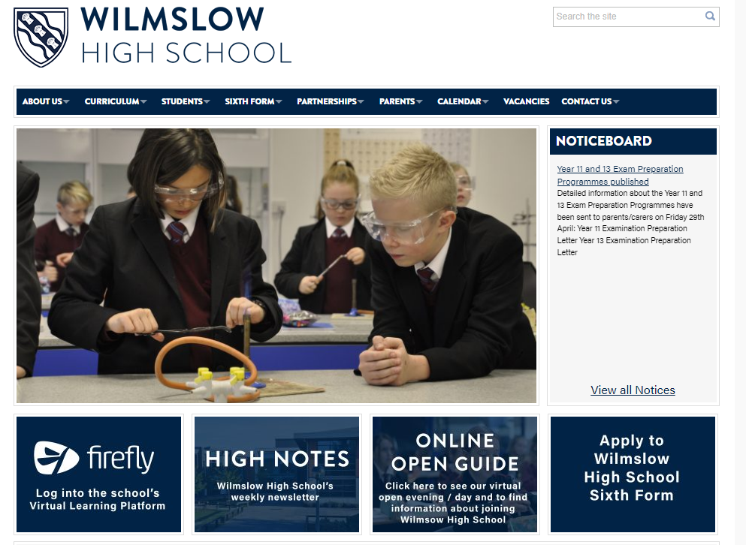
Accessing firefly
Go to
www.wilmslowhigh.com
Select firefly

Slide 4
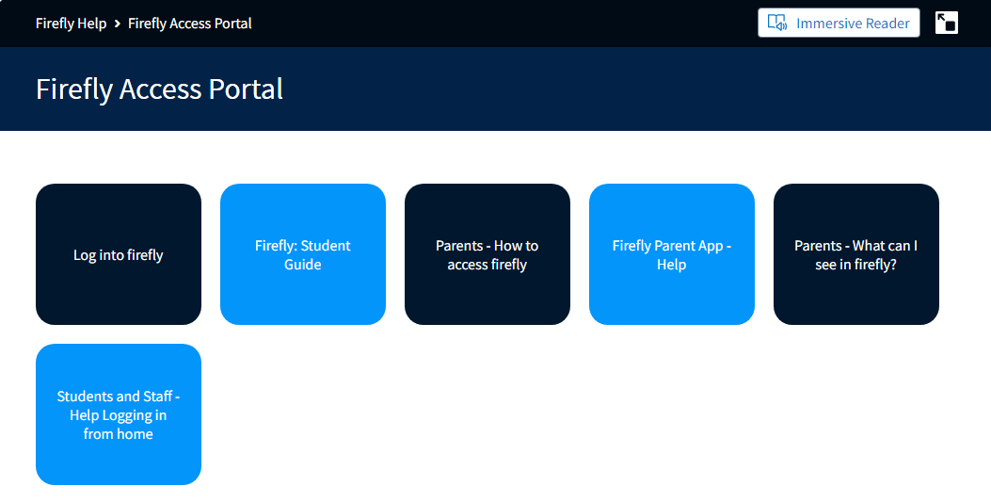
Choose ‘Log in to firefly’

Slide 5
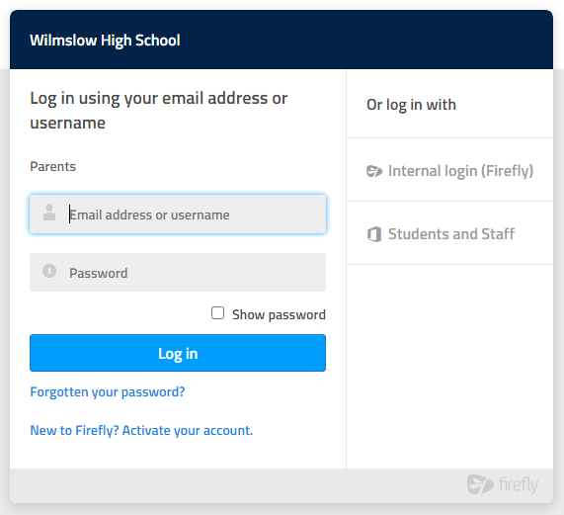
Select ‘New to firefly? Activate your account’

Slide 6
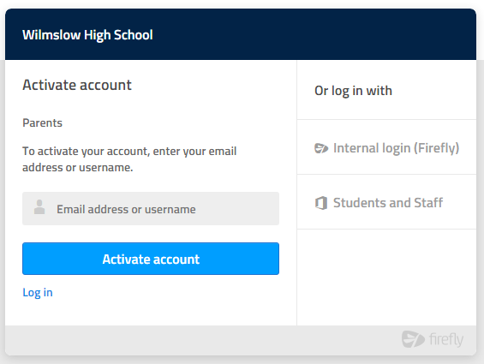
Enter your email address
Enter the email address school holds for you, press Activate account and an activation email is sent to you.
Open the email (check your junk folder if you can’t see it) and select Activate account
Choose a password
Activate account

Slide 7
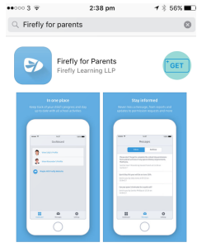
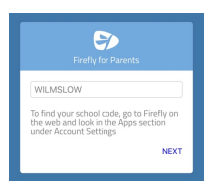
Using the app
If you prefer you can use the firefly app
Search for and download ‘Firefly for parents’ from your app store
Tap the icon to get the app
Enter the school code: WILMSLOW
(you can also register for the first time on the app, using the instructions given for the website)

Slide 8
WHAT YOU CAN VIEW IN FIREFLY

Slide 9
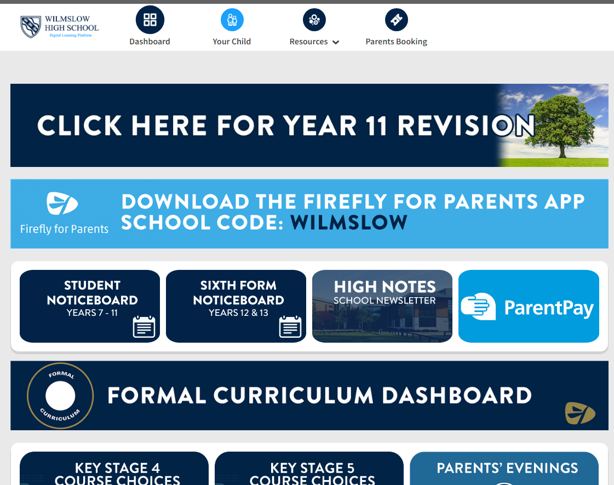
Main dashboard
The main dashboard contains links to useful sections within firefly.
Select ‘Your Child’ to find out about your child’s homework, behaviour and attendance (more about this next)

Slide 10
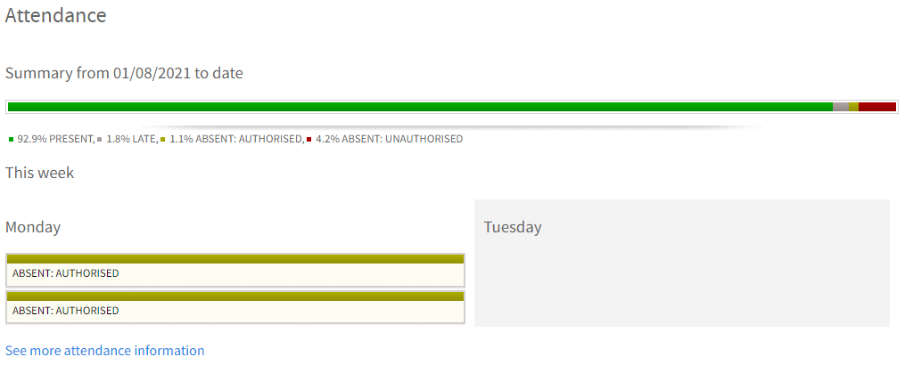
Summary of attendance

Slide 11
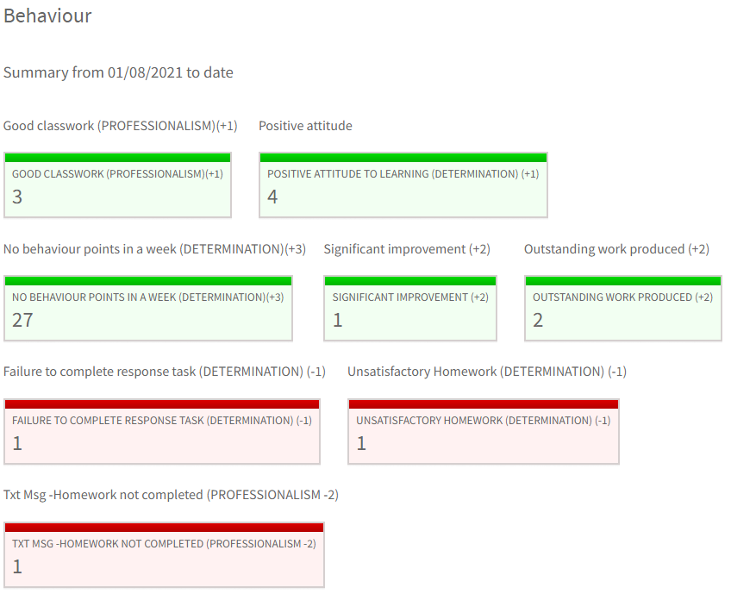
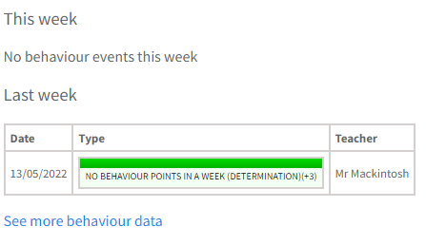
Summary of behaviour and achievement
and week by week incidents

Slide 12
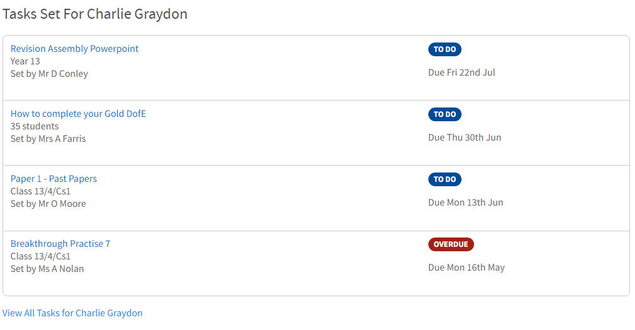
See tasks/homework set for your child
Click on the light blue text for more information

Slide 13
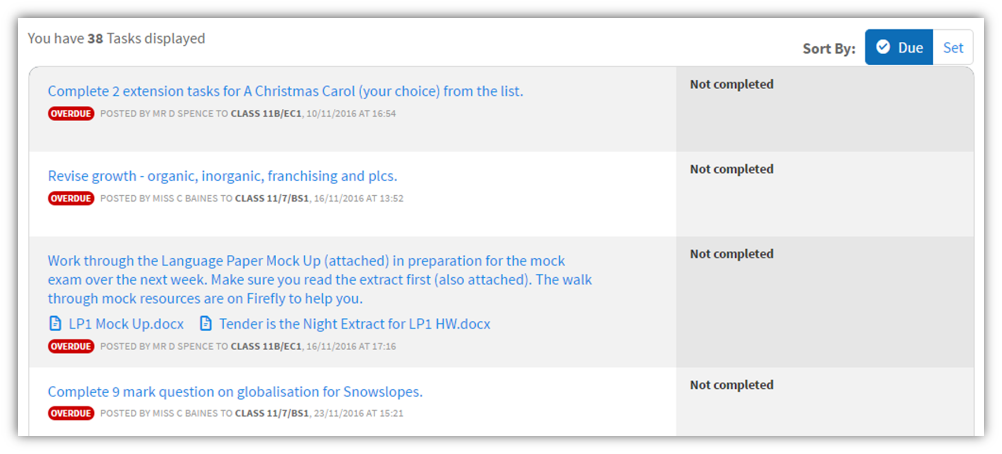
Students must ‘mark as done’ completed tasks or they will show as overdue

Slide 14
The Formal Curriculum dashboard contains lots of useful information

Slide 15
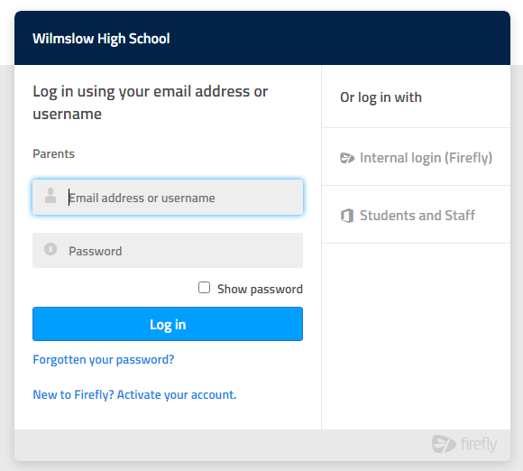
Note, parents log in vs student log in

