Slide 1

Leadership & Social Action
@wilmslowhighschool

Slide 2
Make a difference for yourselves
Impact that the new Year 13 have had on transforming their environment and driving improvement
Sixth Form Leadership Team to work with school Leadership Team on joint school improvement projects

Slide 3
Make a difference for others
Reading
Extra
Progress Bases
Eco Award (and allotment)
Social Action
Fund raising
House leadership
Newspaper

Slide 4
How?
Year 12 weely Leadership period
Year 13 Autumn Term

Slide 5
Why?
UCAS/ C.V.
Qualities as well as qualifications: thriving in a VUCA environment
Wellbeing: agency, efficacy and purpose

Slide 6

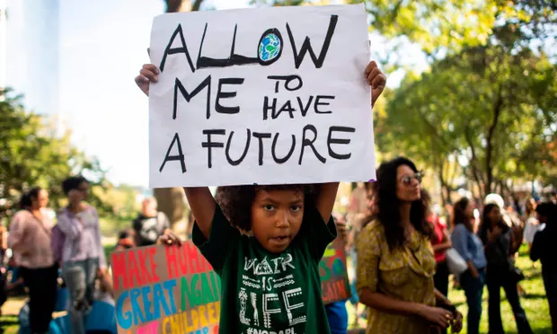


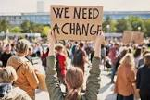
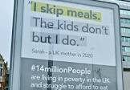
Notes:
I am here today with members of the 6th Form Leadership team to talk to you about two huge leadership opportunities that we are launching this year. Turn on the news, look at your local community, and we can all see the problems which exist. But my challenge to you is to be involved in taking action to do something about this and actually make change. We have in school a fantastic resource in the enthusiasm, creativity and resourcefulness within our student body and with this, this year I want us to make a huge impact across our school and local community.

Slide 7



Year 7
Social Action
Year 8
Eco Schools Award
What's involved?
In this role you will help your allocated Year 7 form run an awareness campaign and fundraiser for their chosen charity.
Lead a fortnightly meeting with your Year 7 form during Friday registration.
Support students in the planning of their project using the resources provided.
Run additional lunchtime sessions if needed.
Support the running of your form's campaign and fundraising project.
Be proactive in supporting your form with their project and ensure that all students take an active role.
What's involved?
In this role you will help your allocated Year 8 form to plan and run their chosen environmental project. All projects will contribute to the schools Eco-School Award.
Lead a fortnightly meeting with your Year 8 form during Friday registration.
Support the running of an after-school Eco Committee once every half term.
Support students in the planning of their environmental project using the resources provided.
Be proactive in supporting your form with their project and ensure that all students take an active role.
Notes:
https://www.media.barclays.co.uk/player/?id=172455-1973020

Slide 8



NCS &
The Pledge
2023-24

Slide 9
Ice Breaker

Slide 10

What is
NCS ?

Slide 11
Personal Development Programme

Slide 12
Be the best version of yourself

Slide 13



Slide 14
Social Action
Life Skills
Employability
Over 9 months

Slide 15




Community Projects
Trips / Site Visits
Activities

Slide 16
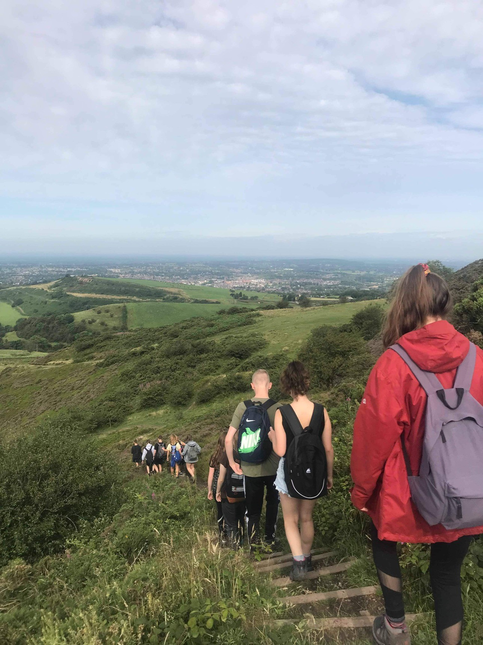
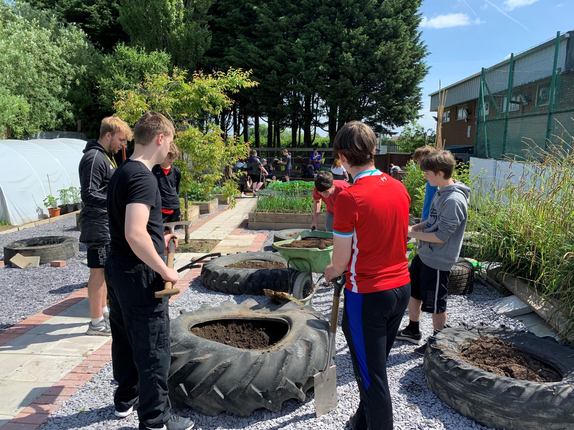
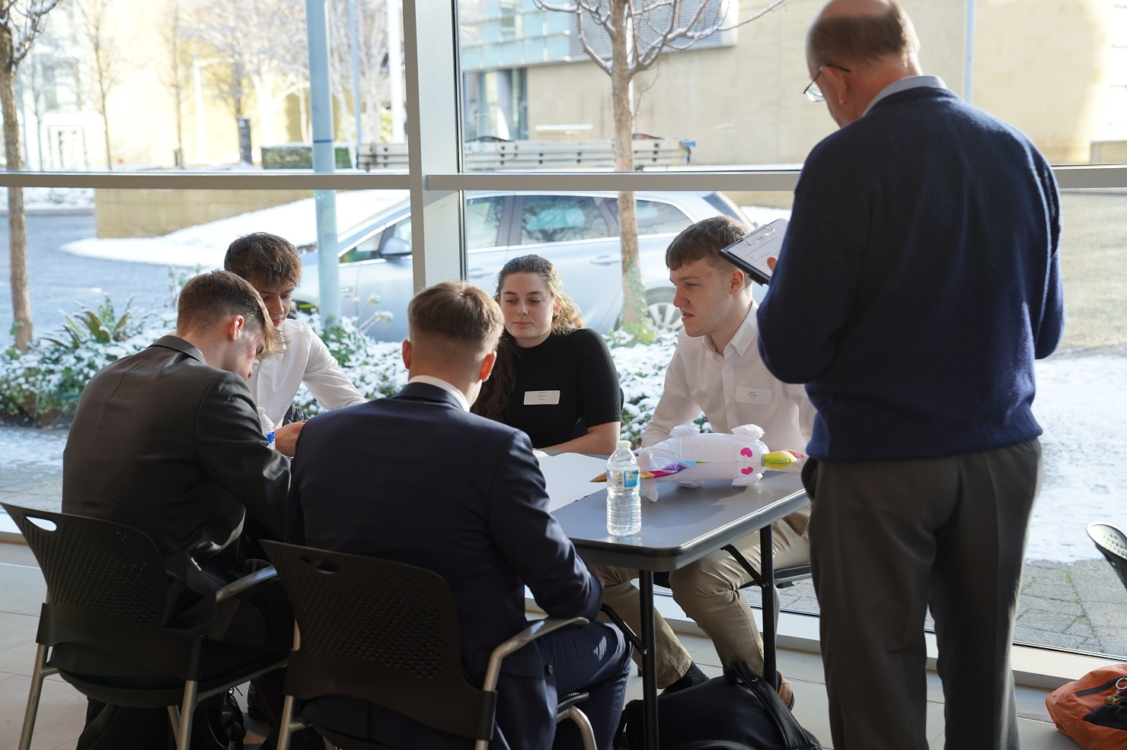
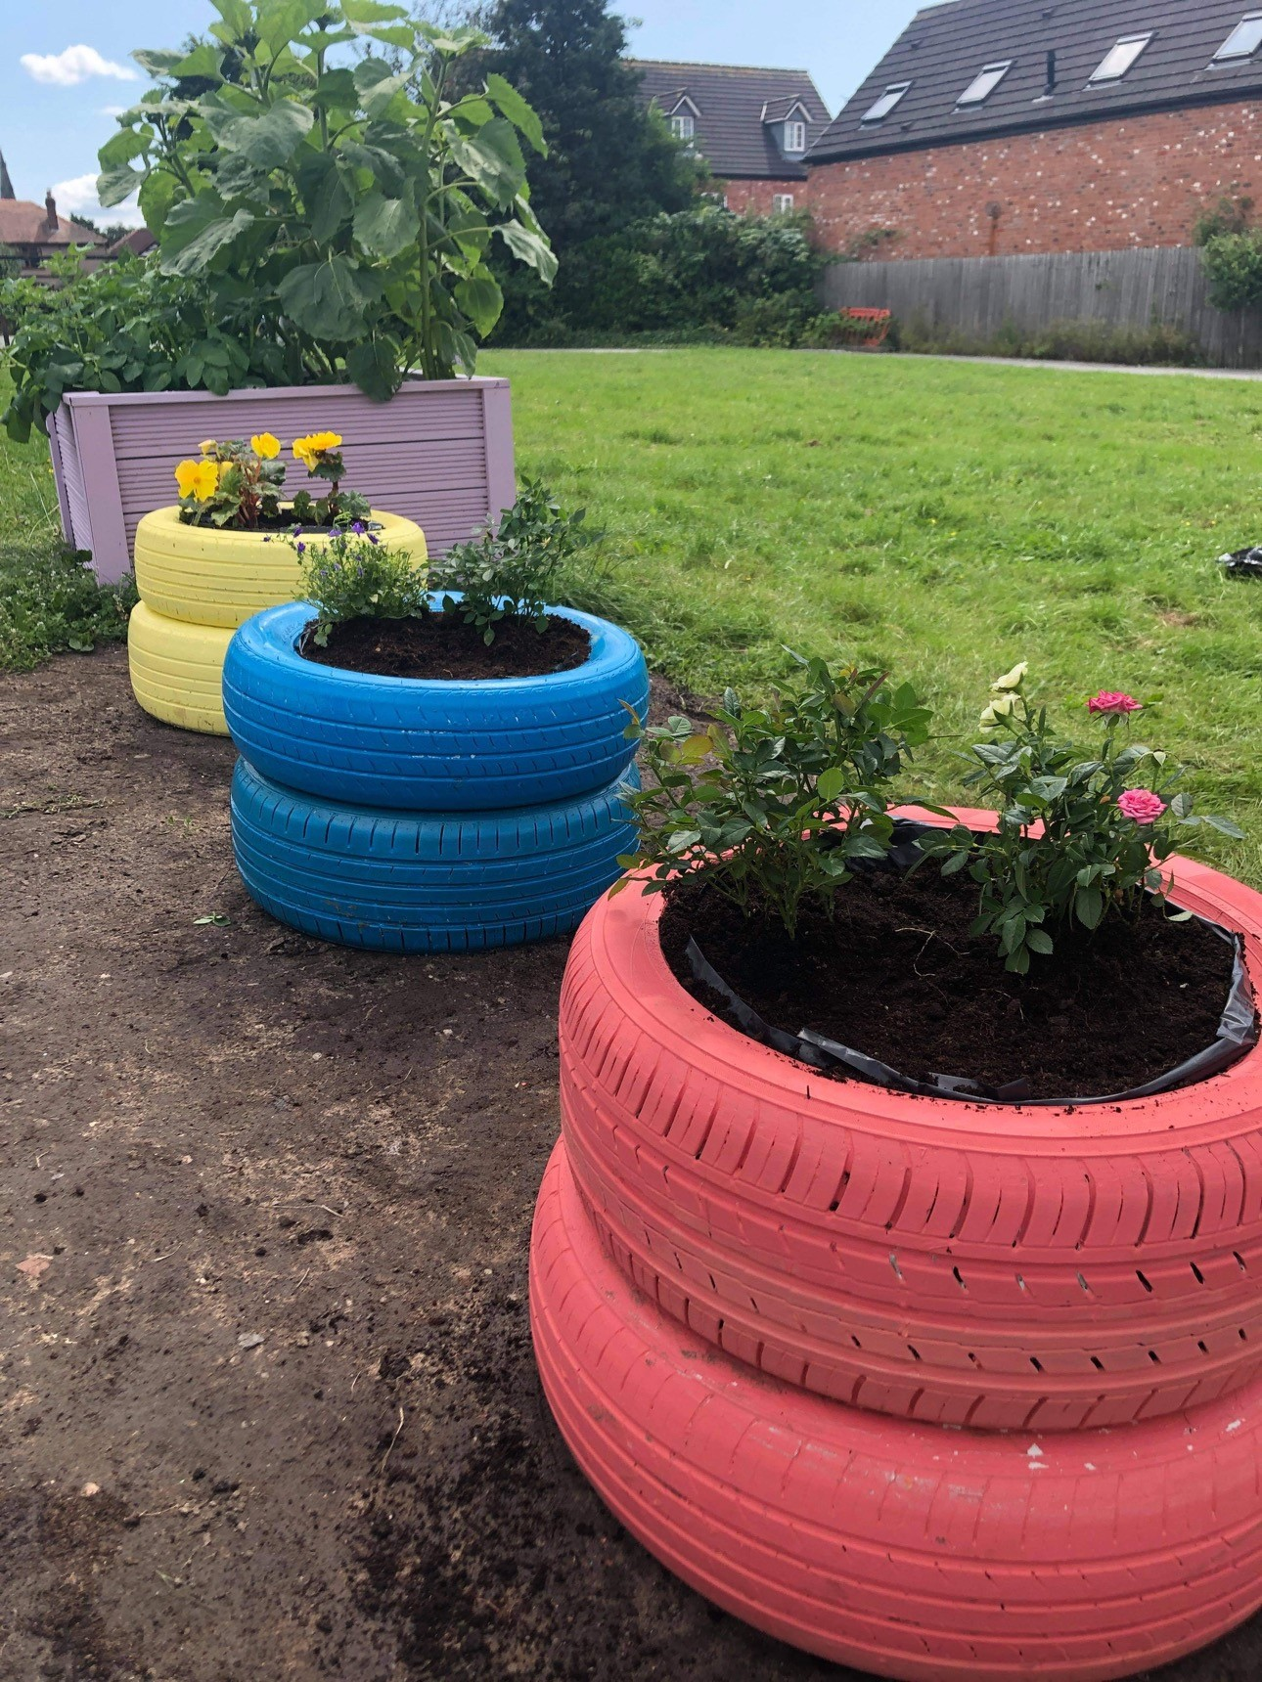
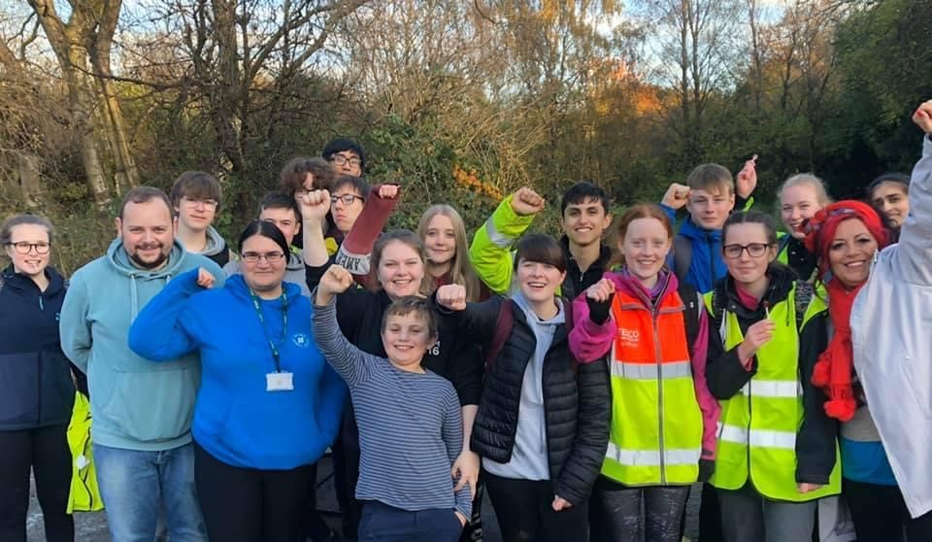

Slide 17









Apprenticeship
College
University
Meet new young people
Leadership Skills
Manage a Project
HAVE FUN!
Become more Employable
Interview Skills
Supercharge your CV
Communication Skills

Slide 18

Interested in becoming the best version of yourself?
Sign up today!

Slide 19
NCS &
The Pledge
2023-24

Slide 20

The WHS Journal aims to give you the opportunity to share the stories that you feel need to be heard. This can be anything from book reviews to, creative writing competitions, opinion pieces to cartoons.
We are looking for a group of KS5 students who would be interested in running the WHS Journal this year.
This leadership role will involve:
Promoting the newspaper to lower school students,
Co-ordinating the submission of articles and editing the final newspaper,
Supporting lower school students in putting together their submissions.

Slide 21
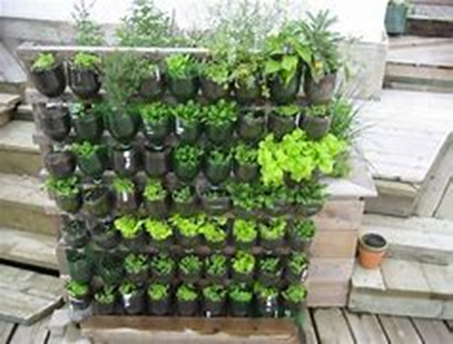
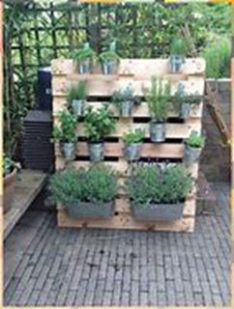
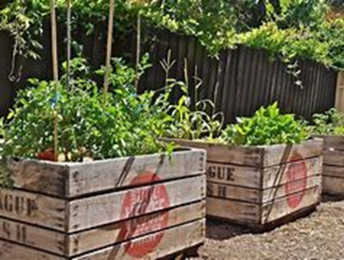
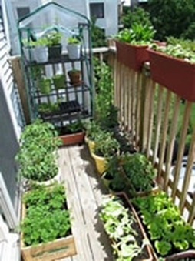
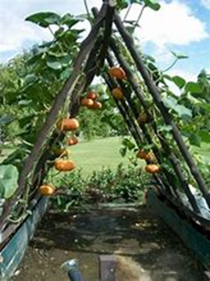
Allotment

Slide 22

Progress Bases

Slide 23

Reading

Slide 24

Lesson Support

Slide 25

Peer Mentoring

Slide 26
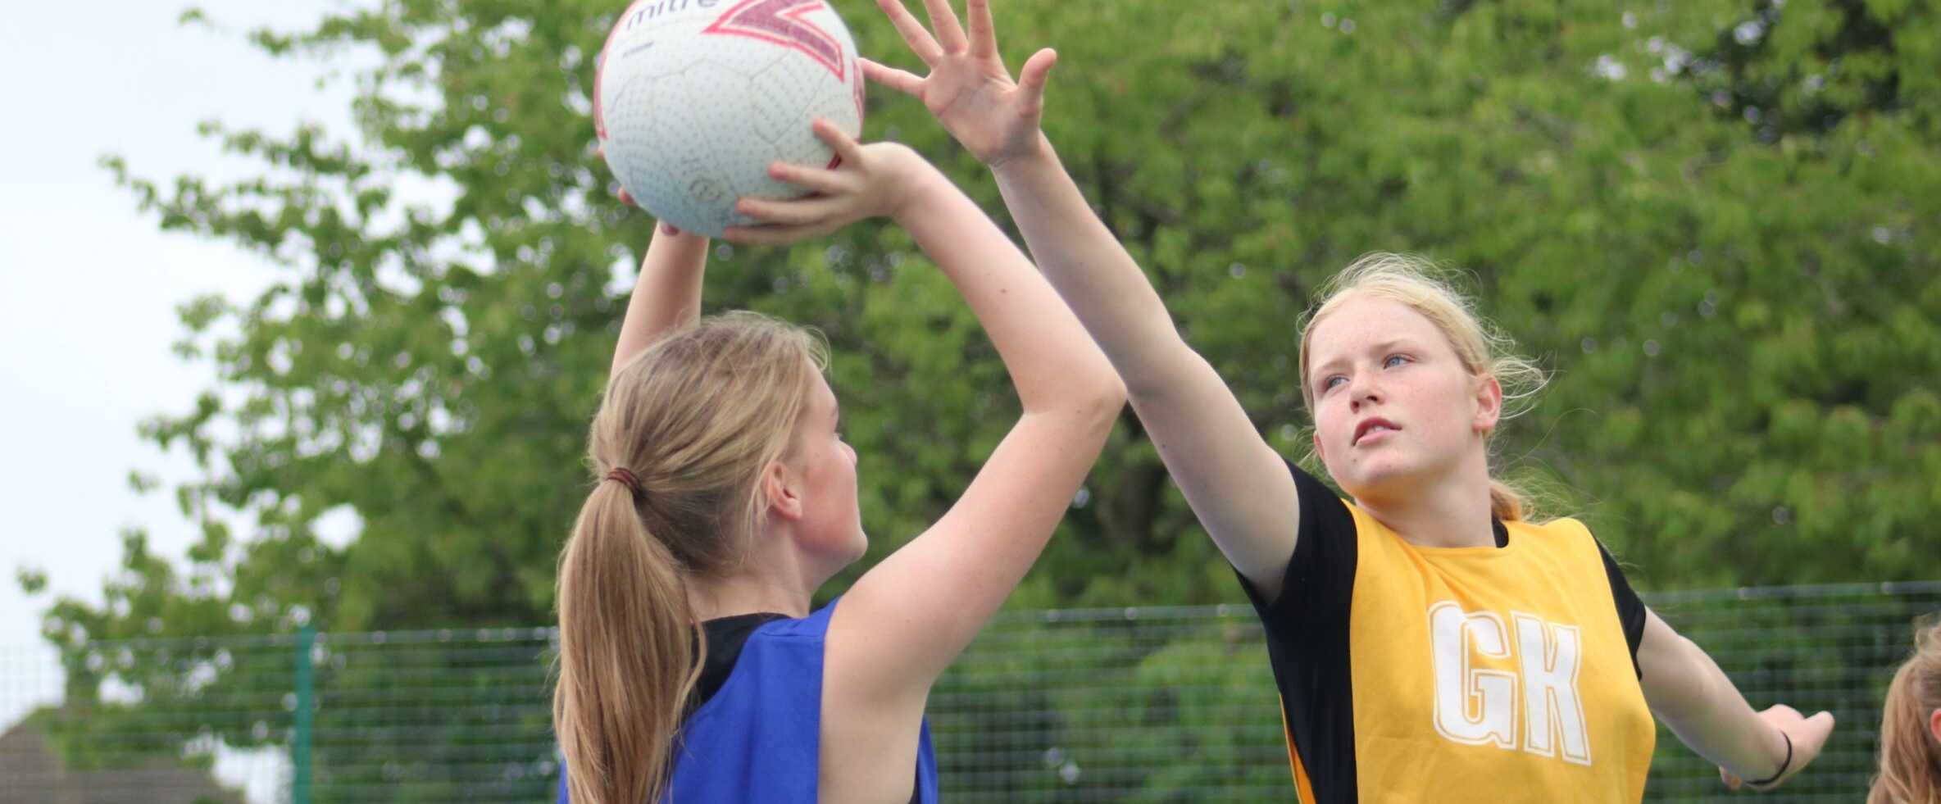
Sports Xtra Support

Slide 27

SEN Homework Club

Slide 28
What is the EPQ?
Extended Project Qualification
Extended piece of research + essay: approx. 7,000 words.
Other options: create a product / performance / conduct an investigation/field study
Opportunity to study something in greater detail
Worth an AS level with UCAS points attached.
Demonstrates you have the independent study skills demanded by employers and universities.
Something to talk about in your personal statement and interview

Slide 29
What is involved?
Compile reading/resource list
Independent work: access & assess sources, make notes & summarise arguments
One lesson per week, either 1:1, small groups, or class sessions to explore and practise necessary skills, review progress, action points, support.
The process – how you research the problem – is as important as the outcome (log book is assessed)
The dissertation is 5,000 – 10,000 words

Slide 30
Want to know more about EPQ?
Zoom meeting, for students (and parents/carers if they wish to find out more)
MONDAY 18TH SEPT 6pm – 6.30pm
https://wilmslowhigh.zoom.us/j/83171163767?pwd=THBpQlplUG93dlQxVVZCeDNZcDk4Zz09
Meeting ID: 831 7116 3767
Passcode: 340378

Slide 31
The Gold DofE Award
"The Duke of Edinburgh's Award"
One of the most highly regarded youth awards
Five sections – Volunteering, Physical, Skills (done over a period of time); Expedition and Residential.
There is a cost attached – approx £460, mainly for the Expedition section
You can take part even if you have not done Bronze or Silver.

Slide 32
Commitment needed
An hour a week for up to a year doing Volunteering, a Physical activity and a Skill
Can be things you do already or a new challenge
A practice (training) expedition for 4 days in July 2024
An assessment (qualifying) expedition for 4 days in late August 2024.

Slide 33
Want to know more about DofE?
Zoom meeting for students (and staff if they wish to find out more)
TUESDAY 19TH SEPTEMBER 6pm – 6.30pm
https://wilmslowhigh.zoom.us/j/89618255639?pwd=eE9oVUsrakFnUVZCRG95QlpaSlduZz09
Meeting ID: 896 1825 5639
Passcode: 508202

Slide 34
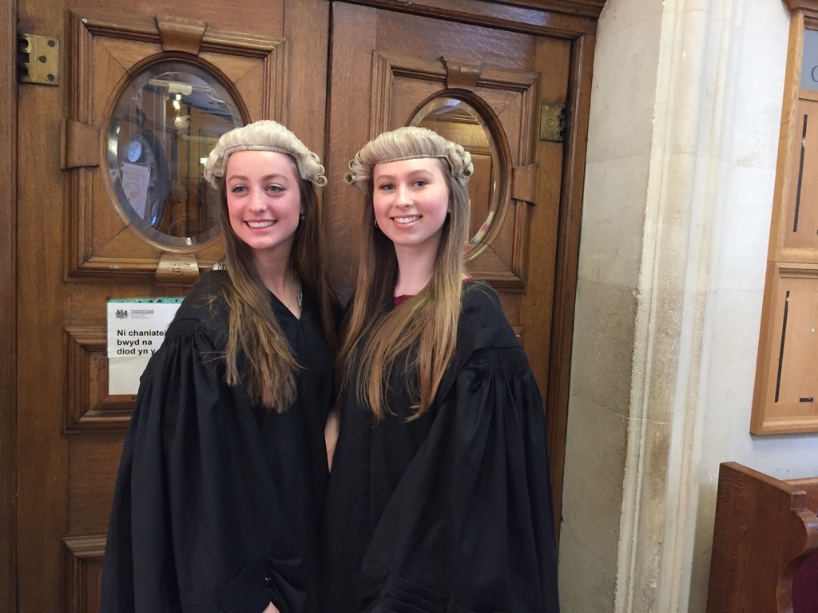
Bar Mock Trial

Slide 35
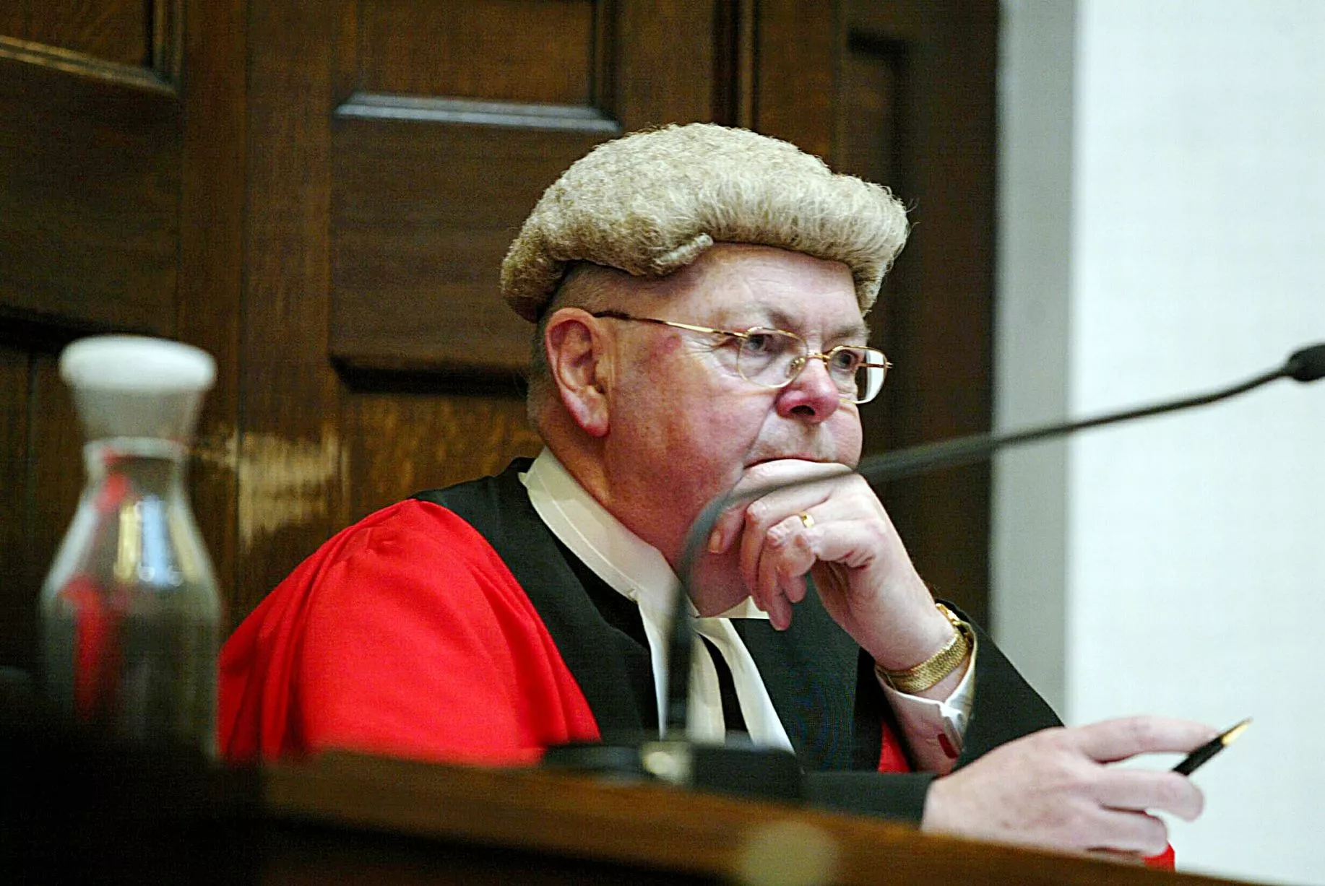
WHAT is it?
It’s a national competition. Hundreds of teams from schools all over the UK compete by arguing in a trial.
Real judges decide who has argued their case best.

Slide 36
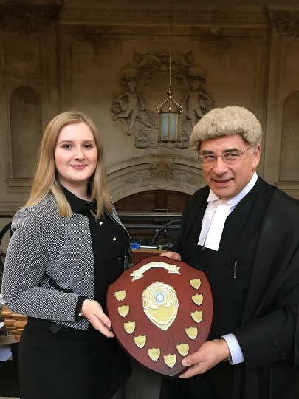
How well has whs done in this competition?
We came in the top 7 teams in the country
6 years in a row.
We came in the top 3 teams 3 years in a row.
We have won the whole competition.

Slide 37
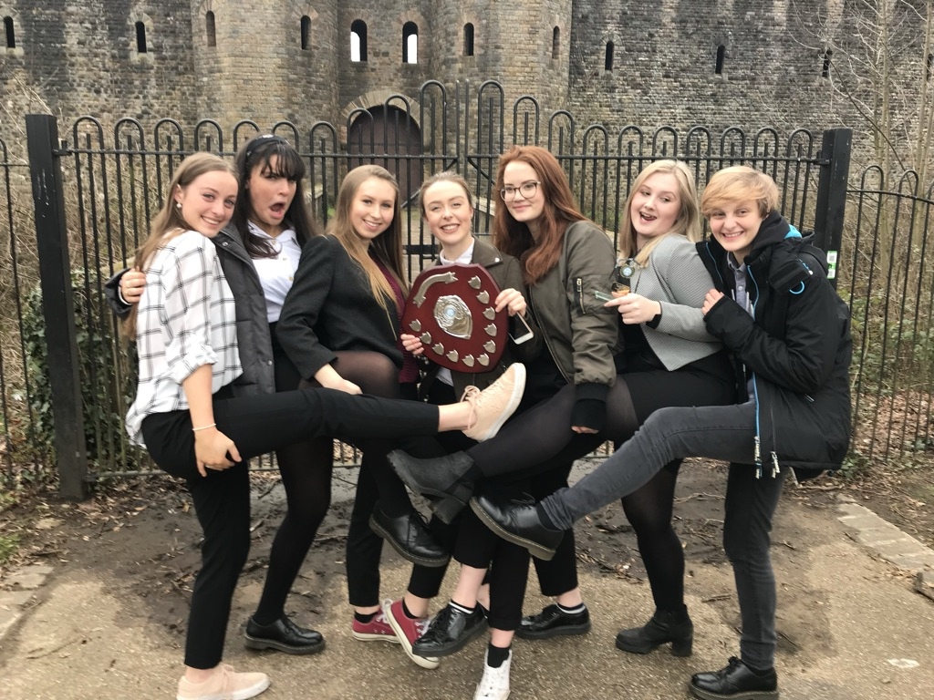
Many students have said it’s the best thing they’ve ever done.

Slide 38
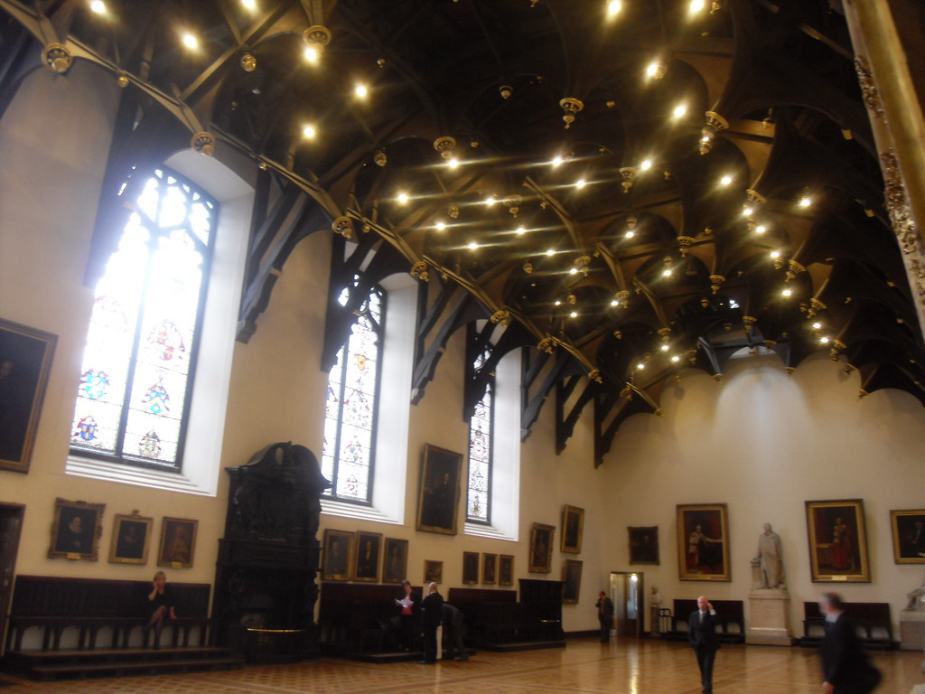
When is it?
The first heat is on a Saturday in November. If we get through to the National Final, it will be in March.
We have competed in National Finals in the Old Bailey, the Royal Courts of Justice, the Edinburgh Court of Sessions, Cardiff and Belfast.

Slide 39
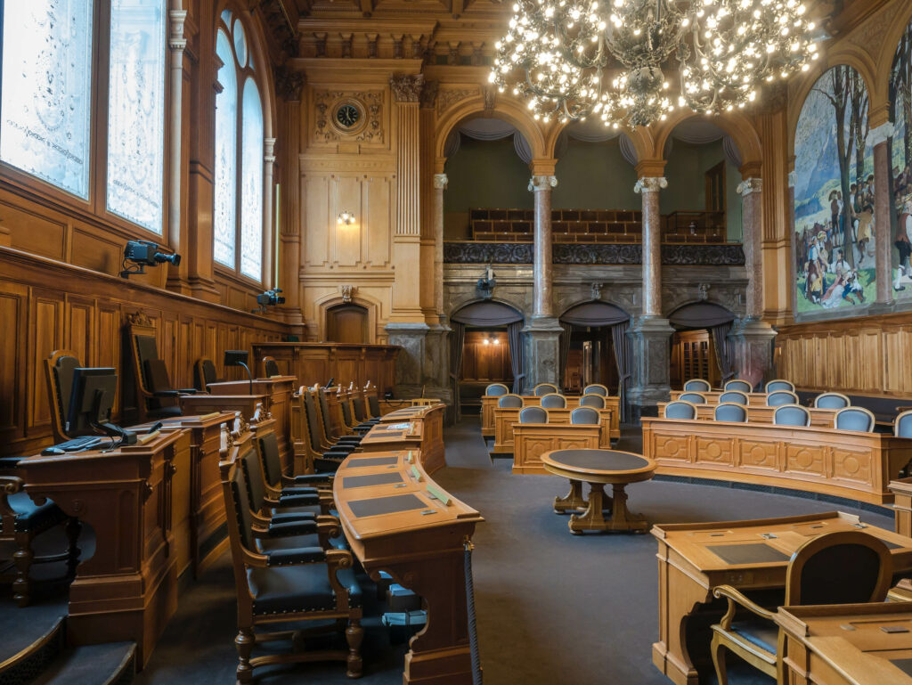
Where does it happen?
In a real Crown Court.

Slide 40

When are the rehearsals?
We have two cases.
We will rehearse one on Wednesdays and the other on Thursdays after school and during enrichment when possible.
You don’t need to be involved in both cases.

Slide 41
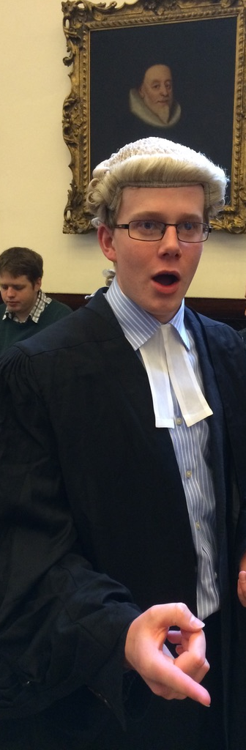
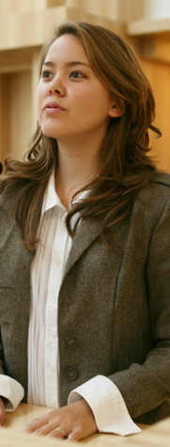
What would I have to do?
You can be:
A barrister (questioning witnesses, arguing, convincing)
  You need to think on your feet and respond to what witnesses say
  You will need to undermine the other side’s witnesses
A witness (stating and arguing your case)
  It helps to be argumentative!
  You’ll need to act and stick to your case
A clerk (presiding over the court)
  You can learn this role. It doesn’t involve improvisation.
An usher (showing witnesses where to go and swearing in)
  You can learn this role. It doesn’t involve improvisation.
A juror (listening to the evidence and returning a verdict)

Slide 42
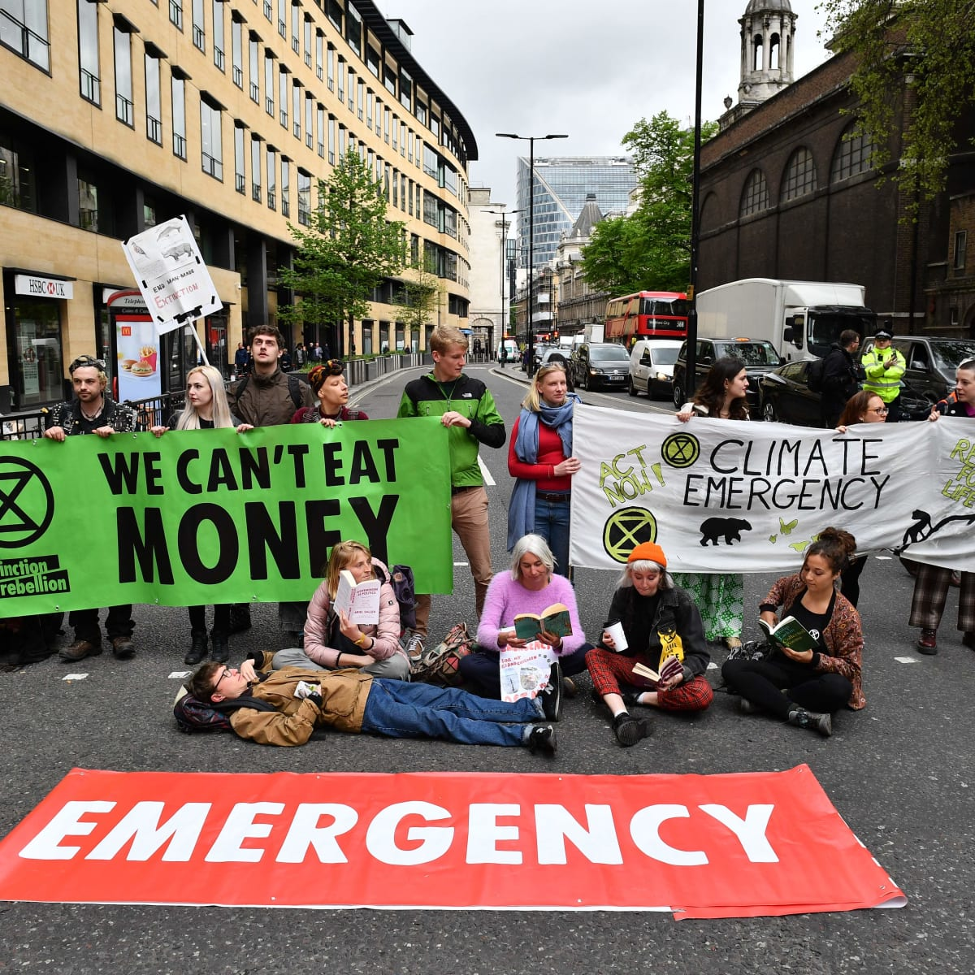

What are the cases about?
One is about computer hacking
The other is about aggression at a protest

Slide 43
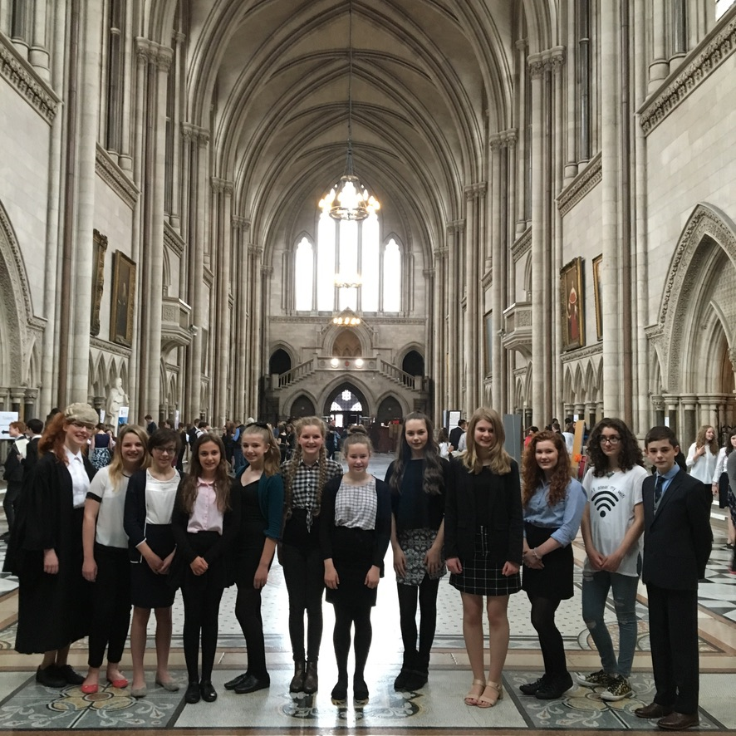
Is it a big commitment?
There will be no more than one rehearsal a week, apart from the week before the competition.

Slide 44
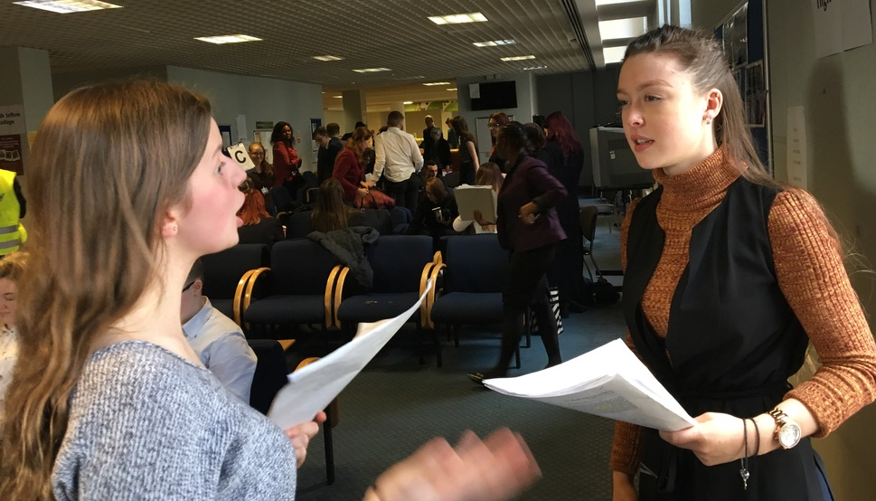
Do I need any prior experience?
No, however…
It helps if you like ARGUING
It helps if you like ACTING
It helps if you like PULLING EVIDENCE TO PIECES AND PUTTING IT BACK TOGETHER AGAIN!

Slide 45
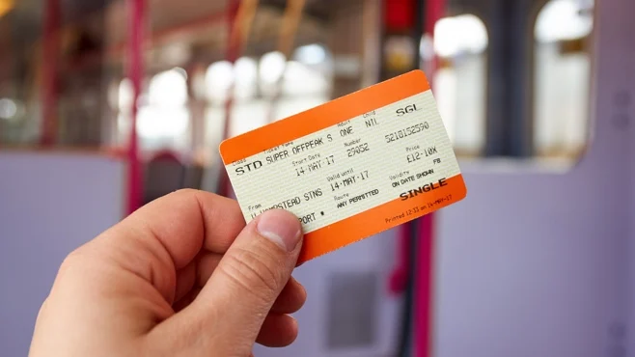
Do I have to pay anything?
No. Just transport costs on the day.

Slide 46
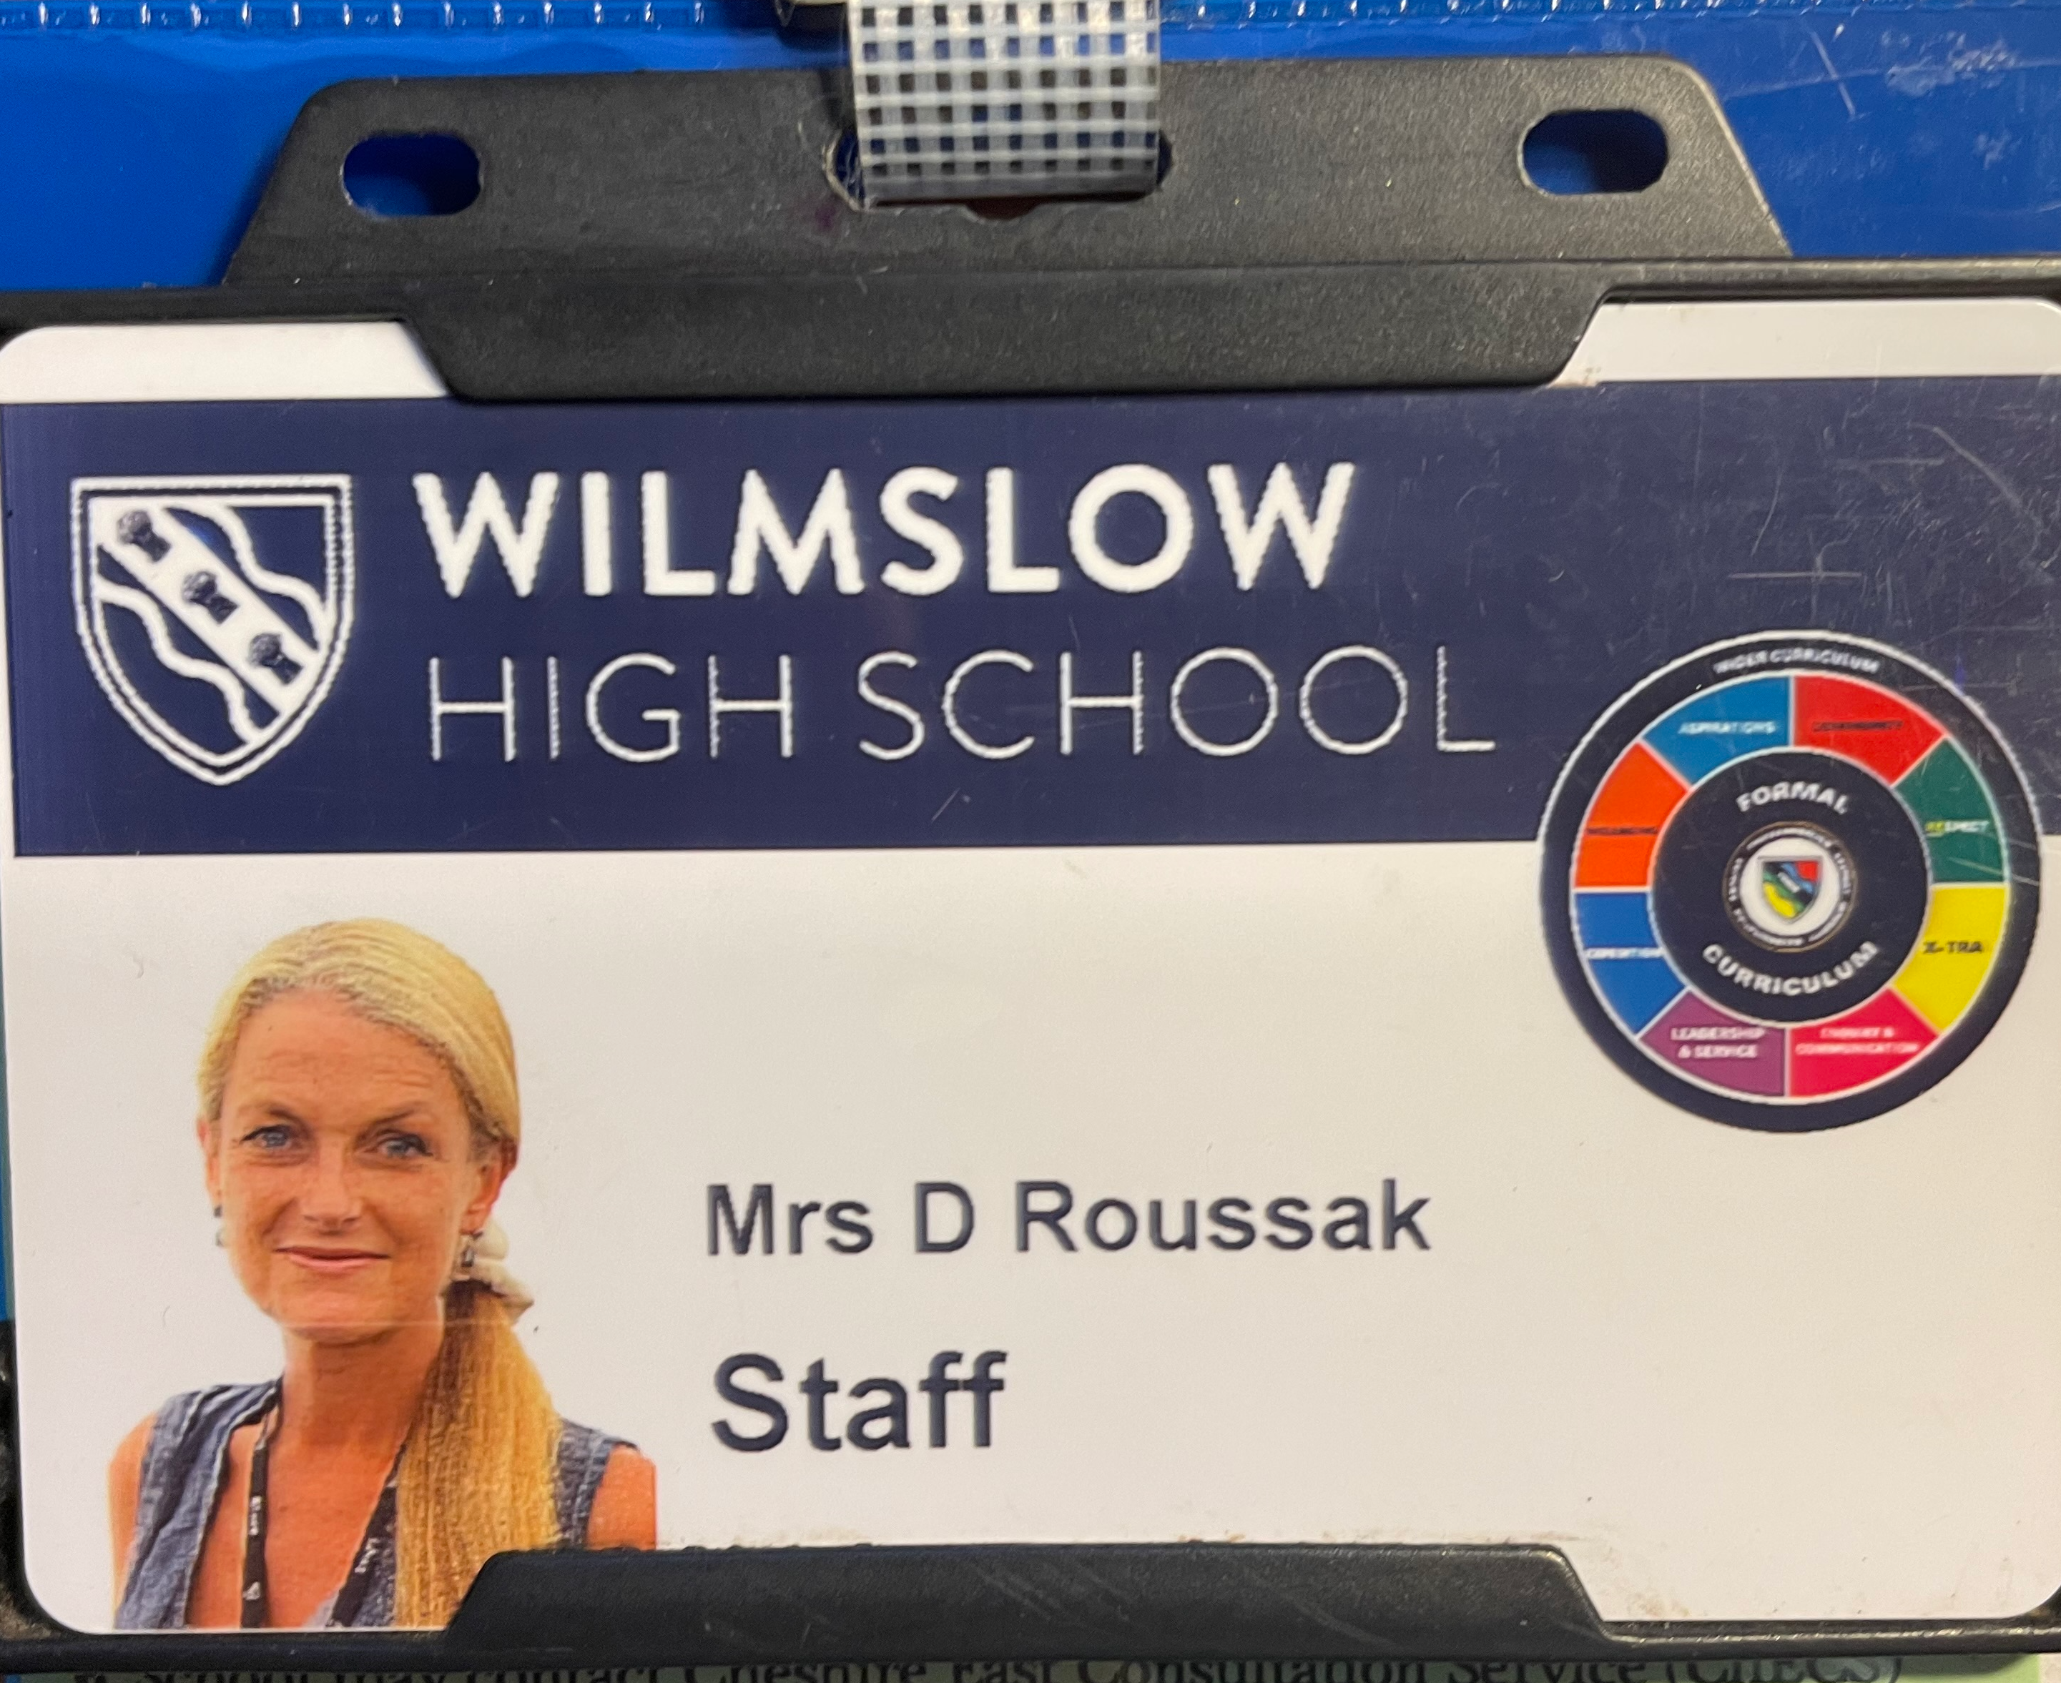
Interested?
Speak to Mrs Roussak
She lives in the Social Studies office between rooms 30 and 31.

Slide 47
Young Enterprise – Year 12
A National competition run by Young Enterprise
Work in a group
Set up and run a company over the year with the support of a local business advisor
Meet with your advisor once a week
Compete against other schools
Learn how to run a business, deal with suppliers, advertising, give presentations, produce accounts,
Problem solving, team work, decision making
Link teachers Mrs Buckley and Mrs McHarg

Slide 48
Sport
Competitive: Hockey, Netball, Rugby, Football
Training and Fixtures
Social: Badminton, Basketball, Table Tennis, Trampolining, Chess

Slide 49
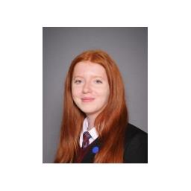
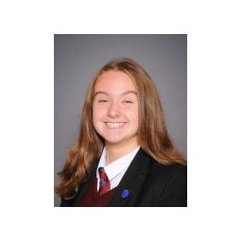
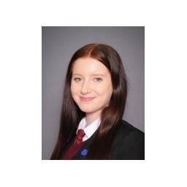
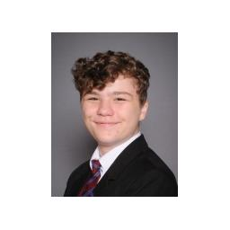
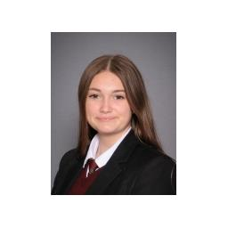
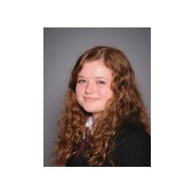
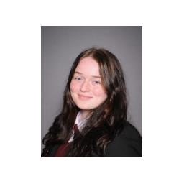

Performing Arts Enrichment
Wilmslow High School Arts Ambassadors
Alice Legge
Rosa Coan
Emily Legge
Oskar Jackson
Holly Higson
Leila Vigerstaff
Lily Hawley
What we can offer:
Acting
Singing Performance
Dance Performance
Musical Theatre
(Forward facing roles)
Director
Choreographer
Set Design
Costume Design
Lighting and Sound
Playwright
(Behind the scenes)
Project based with a view to perform termly/half termly.

Slide 50

Creative Writing
Book Club

Slide 51

TEFL
“TEFL” is the acronym for Teaching English as a Foreign Language or, simply put, English language instruction for non-native speakers.
A TEFL (Teaching English as a Foreign Language) certificate is an internationally recognized professional credential that certifies that its holder is qualified to teach English as a foreign language.
Cost involved, but can be paid for if there is a commitment to supporting lower school students.

Slide 52
Early Applicants – Oxford, Cambridge, Dentistry, Medicine, Veterinary Science
Year 13
Meetings will run every Wednesday period 4
Year 12
Initial meeting in the next few weeks during morning registration
Your regular meetings will start around Easter

Slide 53
Why do we think enrichment is so important?

Slide 54


Slide 55
Getting good A Level/BTEC results (and potentially a good degree) isn't enough
We want to support you to become a well-rounded individual who is developing the right qualities and skills to become a sought-after employee in the future.
So, make the most of these opportunities – this really is a fantastic range of choices!

